Slide 1
Software Testing

Slide 2
Two important parts in the software
1(
Building the right software

Slide 3
Two important parts in the software
1(
Building the right software
2(
Building the software Right

Slide 4
Two important parts in the software
1(
Building the right software
2(
Building the software right
Automated test can help us

Slide 5
HOW?
Documentation
-Technical Document
-Business Document

Slide 6
HOW?
Documentation
-Technical Document
-Business Document
Refactoring

Slide 7
HOW?
Documentation
-Technical Document
-Business Document
Refactoring
Feedback

Slide 8
HOW?
Documentation
-Technical Document
-Business Document
Refactoring
Feedback
Save Time and Money

Slide 9
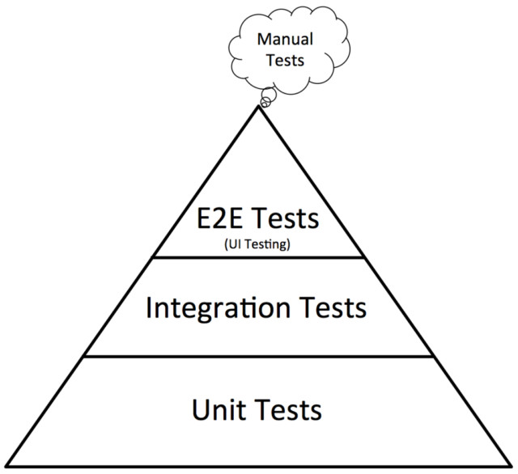
Slower
expensive
Faster
Cheaper

Slide 10
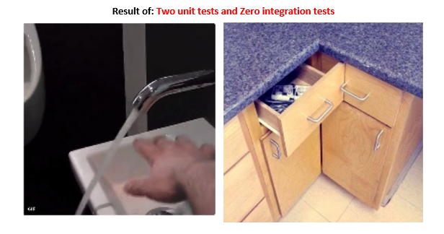

Slide 11




Test Frameworks
C#
Java
- Xunit
- Junit
PHP
Python
- PHPUnit
- Pytest

Slide 12
Write the first test

Slide 13
3 LAWS OF TDD
You can’t write any production code until you have first written a failing test.
You can’t write more of a unit test than is sufficient to fail, and not compiling is failing.
You can’t write more production code than is sufficient to pass the currently failing unit test.

Slide 14
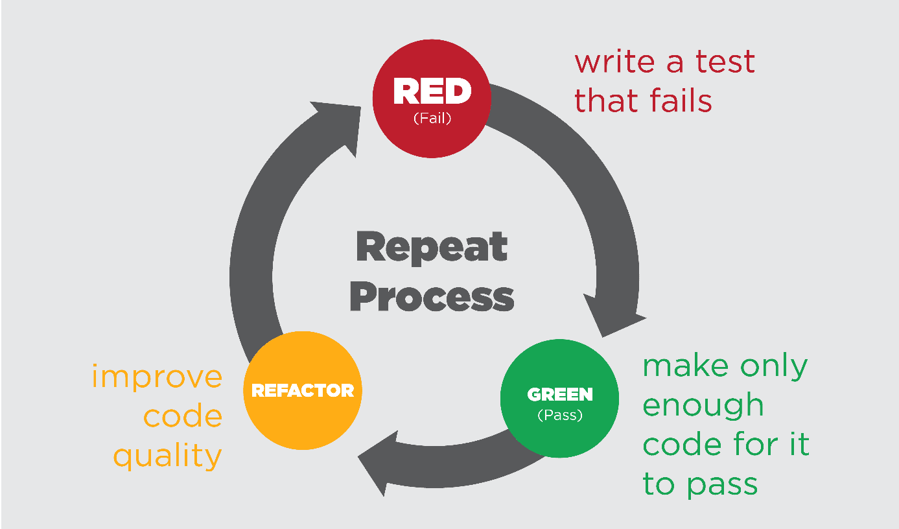
TDD Cycle

Slide 15
Why use TDD?
Better program design
-Two Hat Rule

Slide 16
Why use TDD?
Better program design
-Two Hat Rule
Write the code that exactly does what we want exactly

Slide 17
Why use TDD?
Better program design
-Two Hat Rule
Write the code that exactly does what we want exactly
Fast Feedback

Slide 18
Thanks

